Slide 1
Source Control
Or why Dropbox, Google Drive, Emails, and Thumb Drives
are not enough.

Slide 2
Scenario A: Part 1
Timmy the Web Developer is contracted by Carl the Client to design and create a simple website for Carl‘s bee keeping business.
Timmy takes a week and finishes the first iteration of the website. Timmy shows Carl his work.
Carl loves it!
Carl gives feedback about some element placement, maybe some font changes and color tweaks.
Timmy writes this feedback down and takes the next week to continue work on the website.

Slide 3
Scenario A: Part 2
Timmy is almost done with the final version of the website after 2 months!
Carl drops by Timmy’s place of residence, invites himself in, and loudly announces that the website is ‘not what is currently needed’.
Timmy hates this!
Carl makes a suggestion that the version Timmy had 1 week in to the project was sufficient…
…except now he wants that base website rewritten entirely in PHP so that the other developers can work on it as well.
Timmy asks: “….what other developers?”

Slide 4
Scenario A: The Questions
How is Timmy supposed to revert back to a version that long ago?
How is Timmy supposed to share all his code with these other developers?
Why does Carl hate Timmy?

Slide 5
Scenario A: Part 3
Timmy, out of options, starts the project over in PHP.
Dave the Developer now works with Timmy.
Timmy hates this!
Too bad, Timmy. Teams are about efficiency.
Carl the Client now wants work to move forward in parallel.
He tasks Timmy with a new contact page…
…and tasks Dave with hooking up some database stuff.

Slide 6
Scenario A: Part 4
Dave and Timmy need to share work. They settle on dropbox.
Nick hates this!
It is cumbersome and error prone, but they manage to share their work.
Carl the Client shows up uninvited again and loudly announces he’s received further funding for his business.
Carl loudly announces he will hire 3 new developers.
These new developers will begin work immediately and branch out to different areas of functionality for the website

Slide 7
Scenario A: Part 5 – The Final Chapter
Carl and the new developers all show up at Timmy’s place of residence unannounced.
Timmy hates this!
Each developer is yelling how they need parts of other people code to complete their task.
Carl the Client spits into Timmy’s face and explains how the project should have been completed weeks ago.
Emails, zip files, google drive invites are all thrown around in a misguided attempt to bring order to the project.
Timmy contemplates business school.

Slide 8
END OF SCENARIO A

Slide 9
Scenario B
Timmy keeps up with modern software development practices.
Timmy loves this!
Timmy learns Git, a specific implementation of a distributed version control system
Timmy is hired by a reputable software development shop.
End.

Slide 10
Intentionally Blank

Slide 11
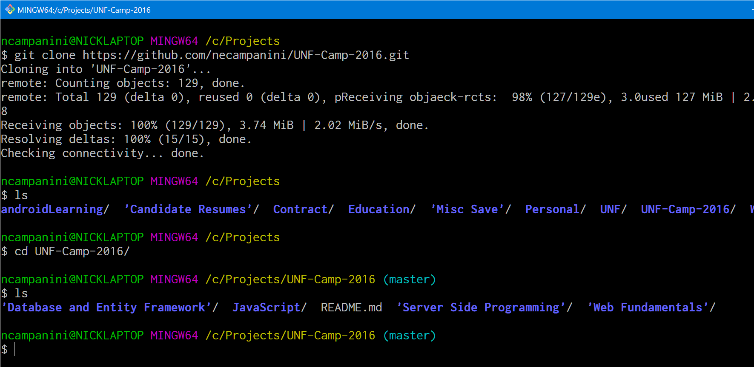
Reference Images
1
2
3
4
5

Slide 12
